Slide 1

SWD 392 - Software Architecture and Design

Slide 2
Software Modeling and Architectural Design
SWD392

Slide 3
Lecture Notes on Software Design
Material is based on Lecture Notes on Software Design
Hassan Gomaa
Dept of Computer Science
George Mason University
Fairfax, VA.

Slide 4
01
Table of Contents
Introduction to Software Design
04
Software Design and Architecture ConceptsML Notation
02
Overview of the UML Notation
05
Overview of Software Modeling
and Design Method
03
Software Life Cycle Models and Processes

Slide 5
01
Introduction to Software Design

Slide 6
1. Section I Hassan Gomaa References: H. Gomaa, “Chapters 1,2-5 - Designing Concurrent, Distributed, and Real-Time Applications with UML”, Addison Wesley Object Technology Series, 2000. H. Gomaa, “Chapters 1-5 - H. Gomaa, “Software Modeling and Design: UML, Use Cases, Patterns, and Software Architectures”, Cambridge University Press, February 2011
Introduction to Software Design

Slide 7
Overview
• Follows general guidelines of Software Engineering Body of Knowledge (SWEBOK) – Chapter 3 Software Design
• Published by IEEE – 2004 Version
– Fundamentals of Software Design
– Software Design Process
– Software Design Concepts
– Software Design Notations and Methods

Slide 8
Software Design
What is design?
As a noun: mental plan, preliminary sketch or outline
As a verb: to conceive in the mind; to invent
What is software design?
As a product
Output of design process
As a process
Approach to doing design

Slide 9
Nature of Design
• Design
– Form of problem solving
• Design as “wicked problem”
– Unlike an algorithm
• There is no one “correct” solution
• Tradeoffs in design
– E.g., Structure vs. performance
– Centralized vs. distributed
– Sequential vs. concurrent

Slide 10
Software Design Activities
• Architectural Design
– Structure system into components
– Define the interfaces between components
• Detailed Design
– Define internal logic
– Define internal data structures

Slide 11
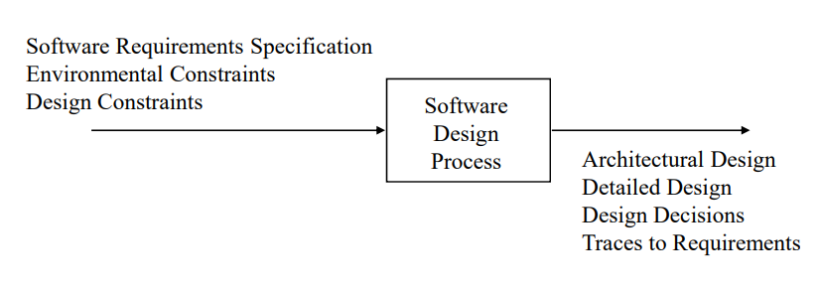
Context of Software Design

Slide 12
Inputs To Software Design
Software requirements specification Inputs To Software Design
Describes WHAT system shall do not HOW
External view of system to be developed
Environmental constraints
Hardware, language, system usage
Design constraints
Design method
Design notation

Slide 13
Software Design Process
Software life cycle(a.k.a. software process)
Phased approach to software development
Software life cycle (a.k.a. process) models
Waterfall – limitations of Waterfall Model
Incremental - evolutionary prototyping
Exploratory - throwaway prototyping
Exploratory - throwaway prototyping
Spiral model – risk driven process model

Slide 14
02
Overview of the UML Notation

Slide 15
Introduction

Slide 16
About UML Diagrams
Use-case Diagram: Defines a sequence of interactions between actors and the system.
Class Diagram: Depicts classes as boxes and relationships between classes as arrows
Communication Diagram: Shows how cooperating objects dynamically interact with each other by messages
Sequence Diagram: Shows objects’ interactions arranged in time sequences
State Machine Diagram: Represent the change of state in the system when an event occurred.
Deployment Diagram: shows the physical configuration of the system in terms of physical nodes and physical connections between the nodes, such as network connections

Slide 17
SLC Models & Processes
Software Life Cycle Model
DESIGN VERIFICATION AND VALIDATION
SOFTWARE LIFE CYCLE ACTIVITIES
SOFTWARE TESTING

Slide 18
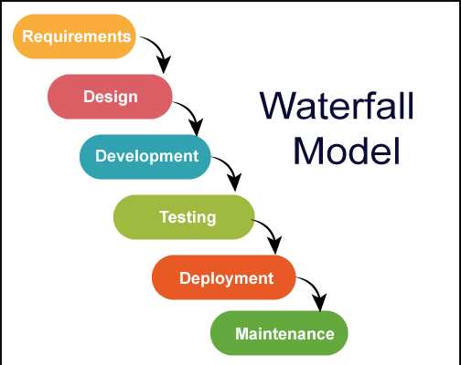
Software Life Cycle Model
Waterfall Model Definition
It is generally considered the conventional or “classical” software life cycle.
The waterfall model is an idealized process model in which each phase is completed before the next phase is started, and a project moves from one phase to the next without iteration or overlap.
Requirements Analysis and Specification
Analysis of user's problem
Specification of "what" system shall provide user
Architectural Design
Specification of "how" system shall be structured into components
Specification of interfaces between components

Slide 19
Limitations of Waterfall Model
Does not show iteration in software life cycle
Does not show overlap between phases
Software requirements are tested late in life cycle
Operational system available late in life cycle
SOFTWARE TESTING

Slide 20
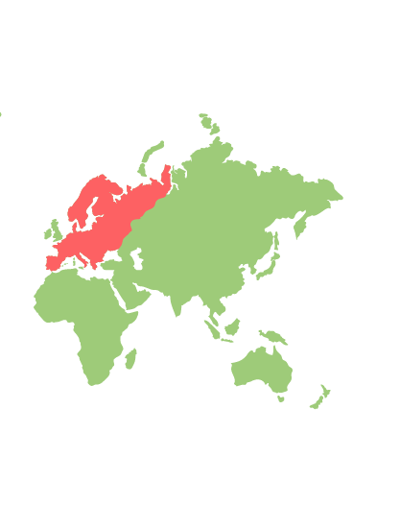
Impact of Throwaway prototyping and its revolution
Particularly useful for getting feedback on the User Interface
Is developed after a preliminary requirements specification
Is an effective solution to the problem of specifying the requirements for interactive information system
Helps overcome the communication barrier that existed between the users and the developers
evolutionary prototyping approach is a form of incremental development in
which the prototype evolves through several intermediate operational systems into the delivered system
Evolutionary prototyping approach is to have a subset of the system working early, which is then gradually built on

Slide 21
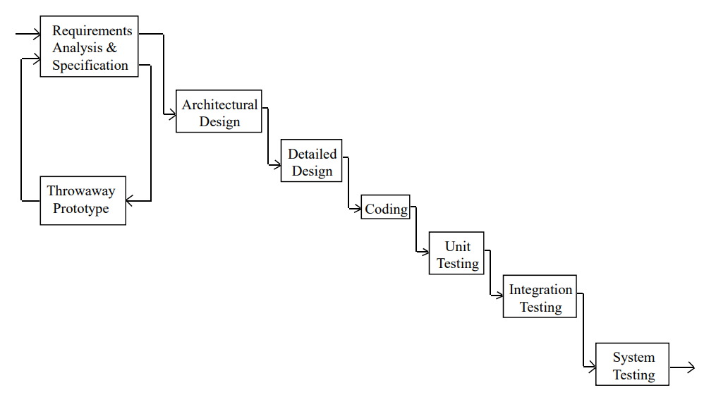
About UML Diagrams

Slide 22
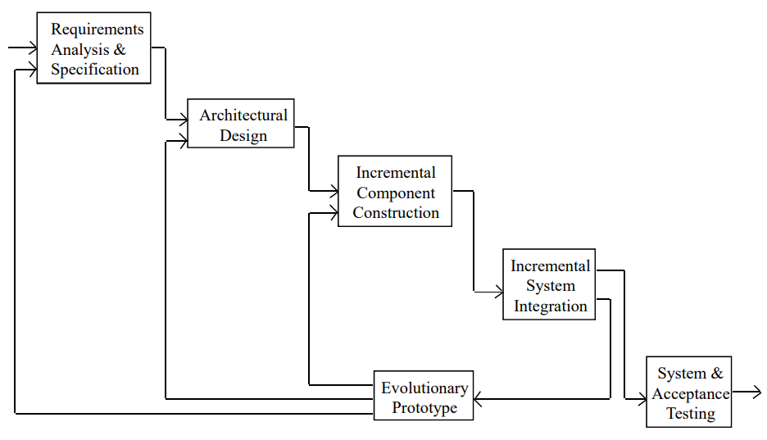
Incremental Development Software Life Cycle

Slide 23
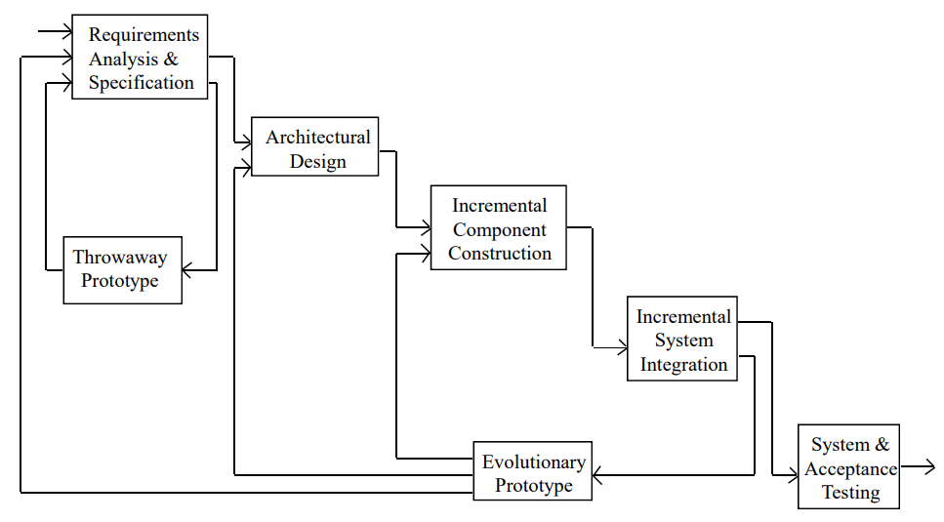
Combined Throwaway Prototyping / Incremental Development Software Life Cycle Model

Slide 24
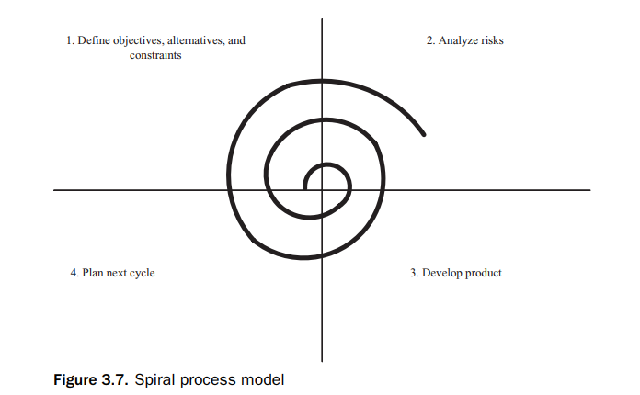
Spiral Process Model (SPM)
Define objectives, alternatives, and constraints. Detailed planning for this cycle: identify goals and alternative approaches to achieving them.
Analyze risks. Detailed assessment of current project risks; plan activities to be performed to alleviate these risks.
Develop product. Work on developing product, such as requirements analysis, design, or coding.
Plan next cycle. Assess progress made on this cycle and start planning for next cycle.

Slide 25
Design verification and validation
Software quality Assurance
Software Life Cycle Activities
Software quality assurance is a name given to a set of activities whose goal is to ensure the quality of the software product
Analyzing the performance of a software design before implementation is necessary to estimate whether the design will meet its performance goals

Slide 26
SOFTWARE LIFE CYCLE ACTIVITIES
Requirements Analysis and Specification
Architectural Design
Detailed Design
Coding

Slide 27
Software Testing
Unit Test
Integration
System Test
UAT
Functional testing
Load testing
Carries out by the end users
Tests on individual components
Uses test-coverage criteria
Involves combining tested components into progressively complex grouping

Slide 28
Software design and architecture concept
Object- Oriented concepts
Design Patterns
Information hiding
Software Architecture and Components
Concurrent processing
Inheritances and Generalization
Finite State Machines
Software Quality Attributes

Slide 29
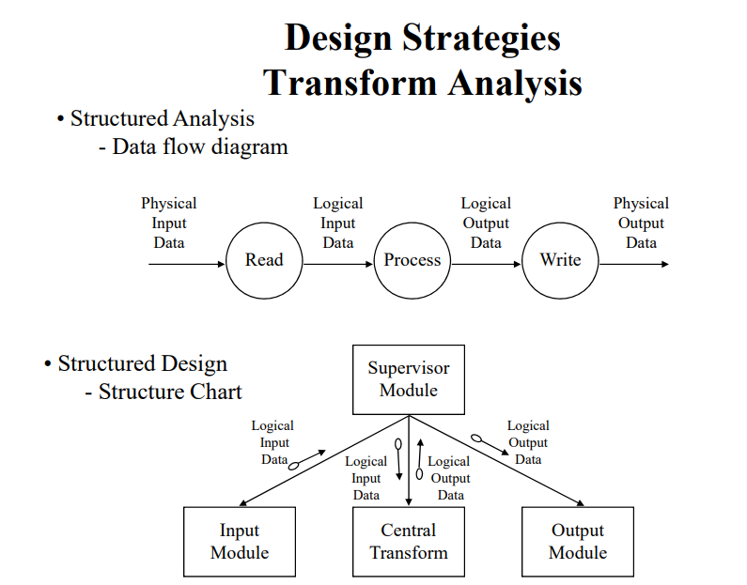
Example of Software Design Method Structured Design

Slide 30
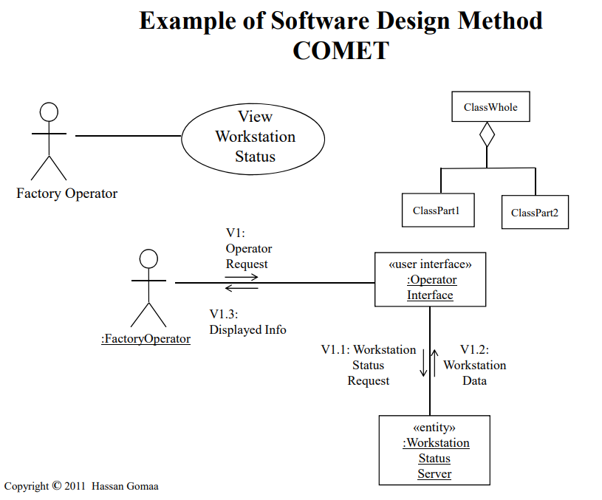
Example of Software Design Method COMET Structured Design

